Slide 1


Slide 2
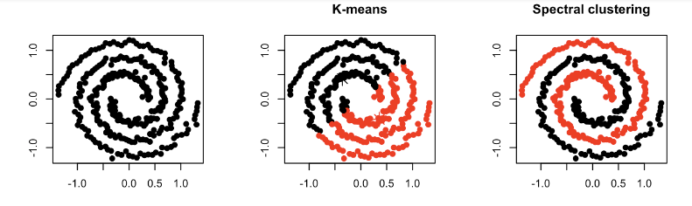

Slide 3

1. Form a distance matrix
2. Transform the distance matrix into an affinity matrix A
3. Compute the degree matrix D and the Laplacian matrix L = D – A.
4. Find the eigenvalues and eigenvectors of L.
5. With the eigenvectors of k largest eigenvalues computed from the previous step form a matrix.
6. Normalize the vectors.
7. Cluster the data points in k-dimensional space.

Slide 4
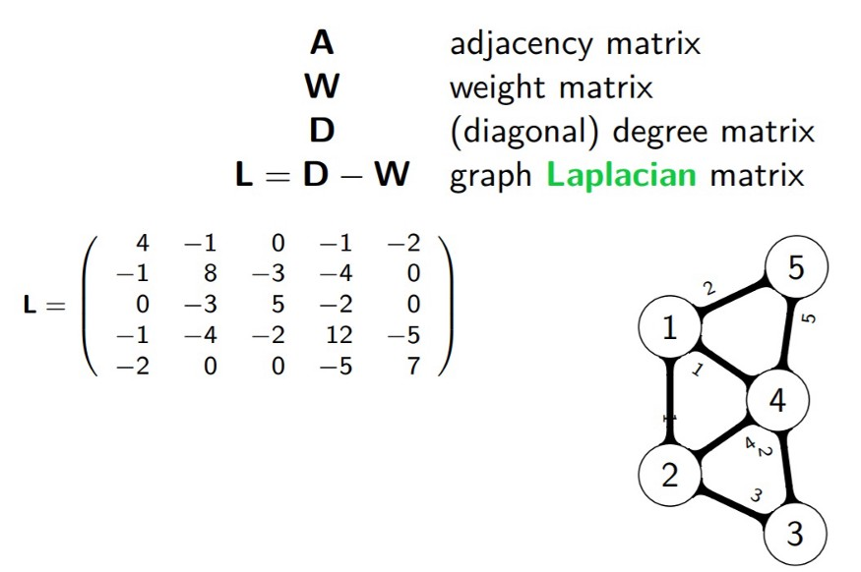

Slide 5
